Slide 1


Java Bootcamp 2018
Class 6: Web Services - REST

Slide 2
Java Bootcamp 2018 - Class 6: Web Services - REST
Have you ever wondered...
how a travel agency contains information about every flight, hotel or excursion?
how the previous one automatically gets updated?
how the previous one scales?
how apps written by different developers interact?
how apps written by different companies interact?
how apps written in different languages interact?
how machine-to-machine communication is achieved?

Slide 3
Java Bootcamp 2018 - Class 6: Web Services - REST
Travel Agency
Airline 2
info
Airline N
info
Approach #1
Services tightly coupled
Need to resolve different programming languages communication
Low scalability
Low performance
Airline 1
info
Reservations agency 1
info
Hotel 1
info
Travel agency 2
info
Hotel 2
info
Hotel N
info

Slide 4
Java Bootcamp 2018 - Class 6: Web Services - REST
Airline 2
Airline N
Airline 1
Approach #2
Services loosely coupled
Need to resolve different programming languages communication → APIs
Scalability
Performance
Separation of concerns
Reservations agency 1
Travel Agency
Hotel 1
Travel agency 2
Hotel 2
Hotel N

Slide 5
Java Bootcamp 2018 - Class 6: Web Services - REST
API
Application Programming Interface
Contract, specification
Set of defined methods of communication between various components
Several usages (both for internal and external consumption)
e.g., Java Interface

Slide 6
Java Bootcamp 2018 - Class 6: Web Services - REST
What should an airline API expose as minimum?
What errors can the airline API have and how should I handle them?
Travel Agency
Airline N
getFlights(Date date)
getPassengers(Flight flight)
buyTicket(Passenger passenger, Flight flight)
How easy is to interact with a new Airline?
What format does this response have?

Slide 7
Java Bootcamp 2018 - Class 6: Web Services - REST
REST
Representational State Transfer
Architecture style (not a protocol as SOAP)
Designing loosely coupled applications over HTTP
No rules → guidelines and good practices
Not a standard in itself, but RESTful implementations make use of standards (HTTP, JSON, XML)
Deal with Resources

Slide 8
Java Bootcamp 2018 - Class 6: Web Services - REST
REST Principles
Uniform interface
Client-Server
Stateless
Cacheable
Layered System
Code on demand
https://restfulapi.net/rest-architectural-constraints/

Slide 9
Java Bootcamp 2018 - Class 6: Web Services - REST
REST: Flow
Client
REST API
REQUEST
RESPONSE
Stateless

Slide 10
Java Bootcamp 2018 - Class 6: Web Services - REST
REST: Flow
Client
REST API
REQUEST
RESPONSE
Let’s take a deeper look on this...

Slide 11
Java Bootcamp 2018 - Class 6: Web Services - REST
Designing a RESTful API: Layering
REST Layer
Client
REQUEST
RESPONSE

Slide 12
Java Bootcamp 2018 - Class 6: Web Services - REST
Designing a RESTful API: REST layer
REST Layer
Receives clients requests and responds accordingly
Client
DTO generation and mapping (will get back to this later)
REQUEST
Auth
Endpoints exposed (http://www.test.com/cart)
RESPONSE

Slide 13
Java Bootcamp 2018 - Class 6: Web Services - REST
Designing a RESTful API: Service Layer
REST Layer
Service Layer
Simil to MVC Controller
Client
Business logic
REQUEST
RESPONSE

Slide 14
Java Bootcamp 2018 - Class 6: Web Services - REST
Designing a RESTful API: Service Layer
REST Layer
Service Layer
Simil to MVC Controller
Client
Business logic
REQUEST
Interaction with other services
RESPONSE
REST Service B
SOAP Service C

Slide 15
Java Bootcamp 2018 - Class 6: Web Services - REST
Designing a RESTful API: Persistence layer
MongoDB
Persistence Layer
MySQL
REST Layer
Service Layer
Client
REQUEST
RESPONSE
Text file
Simil to MVC Model
Data access

Slide 16
Java Bootcamp 2018 - Class 6: Web Services - REST
DTO
Data Transfer Object
Data transfer between different processes
Serialization and deserialization mechanisms
No business logic
Model objects concealment

Slide 17
Java Bootcamp 2018 - Class 6: Web Services - REST
Designing a RESTful API: DTOs
MongoDB
Persistence Layer
MySQL
REQUEST
REST Layer
Service Layer
Client
DTO
DTO
Text file
RESPONSE
Service B
DTO Mapping
Service C

Slide 18
Java Bootcamp 2018 - Class 6: Web Services - REST
HTTP verbs
GET
POST
PUT
DELETE
PATCH
OPTIONS
HEAD

Slide 19
Java Bootcamp 2018 - Class 6: Web Services - REST
HTTP verbs - Idempotency and Safety
Idempotent HTTP methods can be called many times without different outcomes
Safe HTTP methods do not modify resources
 | Idempotent | Safe
GET | Yes | Yes
POST | No | No
PUT | Yes | No
DELETE | Yes | No
PATCH | Yes | Yes
OPTIONS | Yes | Yes
HEAD | Yes | Yes

Slide 20
Java Bootcamp 2018 - Class 6: Web Services - REST
HTTP codes
2xx: success
3xx: redirection
4xx: client error
5xx: server error
https://www.restapitutorial.com/httpstatuscodes.html

Slide 21
Java Bootcamp 2018 - Class 6: Web Services - REST
HTTP codes
2xx: success
200: OK
201: Created
202: Accepted
204: No content
3xx: redirection
4xx: client error
5xx: server error

Slide 22
Java Bootcamp 2018 - Class 6: Web Services - REST
HTTP codes
2xx: success
3xx: redirection
301: Moved Permanently
304: Not Modified
4xx: client error
5xx: server error

Slide 23
Java Bootcamp 2018 - Class 6: Web Services - REST
HTTP codes
2xx: success
3xx: redirection
4xx: client error
400: Bad Request
401: Unauthorized
403: Forbidden
404: Not Found
405: Method not allowed
409: Conflict
415: Unsupported media type
5xx: server error

Slide 24
Java Bootcamp 2018 - Class 6: Web Services - REST
HTTP codes
2xx: success
3xx: redirection
4xx: client error
5xx: server error
500: Internal Server error
502: Bad Gateway
503: Service Unavailable
504: Gateway Timeout

Slide 25
Java Bootcamp 2018 - Class 6: Web Services - REST
JSON
Javascript Object Notation
{
“total”: 2,
“content”: [
{
“name”: “Juan”,
“surname”: “Perez”,
“age”: 30
} ,
{
“name”: “Pablo”,
“surname”: “Gomez”,
“age”: 18
}
]
}
Lightweight data-interchange format
Easy to parse and generate
Language independent
Collection of Name/Value pairs
{
“name”: “Juan”,
“surname”: “Perez”,
“age”: 30
}

Slide 26
Java Bootcamp 2018 - Class 6: Web Services - REST
Jackson
High performance JSON processor for Java
POJO conversion to/from JSON
Provides set of annotations
@JSONCreator
@JsonDeserialize(using = CustomDateDeserializer.class)
@JSONIgnore
@JsonInclude(Include.NON_NULL)
ObjectMapper

Slide 27

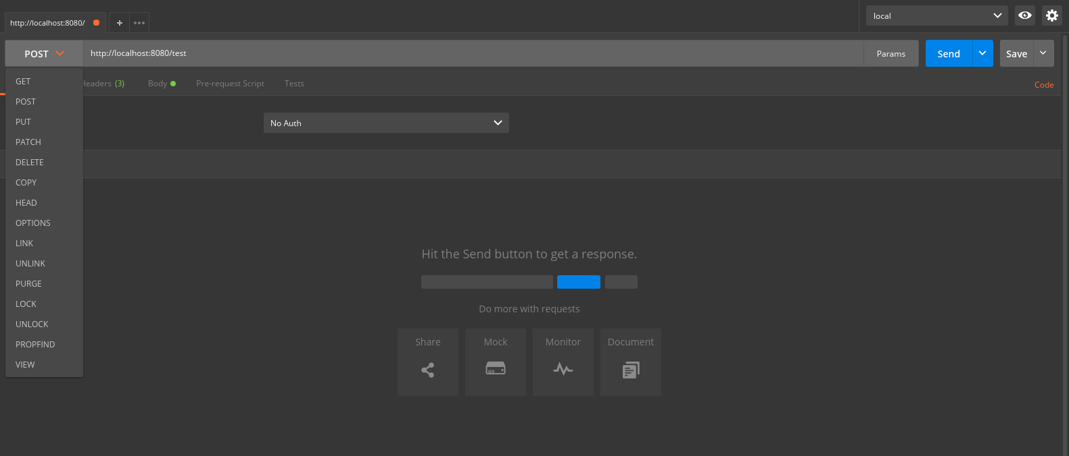
Java Bootcamp 2018 - Class 6: Web Services - REST
Postman
APIs exploration and testing tool

Slide 28
Java Bootcamp 2018 - Class 6: Web Services - REST
REST with Spring Boot
https://spring.io/guides/gs/rest-service/
Set up your REST API in 5 minutes
Jackson included
org.springframework.web
@RestController
@RequestMapping
RestTemplate for consuming other APIs

Slide 29
Java Bootcamp 2018 - Class 6: Web Services - REST
REST API example
Host: www.myrestapi.com
Resource: Flight
GET www.myrestapi.com/flights
GET www.myrestapi.com/flights/{id}
POST www.myrestapi.com/flights
PUT www.myrestapi.com/flights/{id}
DELETE www.myrestapi.com/flights/{id}

Slide 30
Java Bootcamp 2018 - Class 6: Web Services - REST
REST API example - GET flights
$ curl www.myrestapi.com/flights
Response: HTTP/1.1 200 OK
{
“total”: 2,
“data”: [
{
“id”:1,
“origin”: “Buenos Aires”,
“destination”: “Madrid”
},
{
“id”:5,
“origin”: “Madrid”,
“destination”: “Buenos Aires”
}
]
}

Slide 31
Java Bootcamp 2018 - Class 6: Web Services - REST
REST API example - GET specific flight
$ curl www.myrestapi.com/flights/5
Response: HTTP/1.1 200 OK
{
“id”:5,
“origin”: “Madrid”,
“destination”: “Buenos Aires”
}

Slide 32
Java Bootcamp 2018 - Class 6: Web Services - REST
REST API example - GET specific flight
$ curl www.myrestapi.com/flights/6
Response: HTTP/1.1 404 NOT FOUND
No message needed. Specified code is ENOUGH!

Slide 33
Java Bootcamp 2018 - Class 6: Web Services - REST
REST API example - Create flight
$ curl -i -H “Content-Type: application/json” -X POST --data “{“origin”:”Barcelona”, “destination”: “Ibiza”}” www.myrestapi.com/flights
Response: HTTP/1.1 201 CREATED
{
“id”:6,
“origin”: “Barcelona”,
“destination”: “Ibiza”
}

Slide 34
Java Bootcamp 2018 - Class 6: Web Services - REST
REST API example - Create flight
$ curl -i -H “Content-Type: application/json” -X POST --data “{“unknownField”:”Barcelona”}” www.myrestapi.com/flights
Response: HTTP/1.1 400 BAD REQUEST
“You should specify flight origin and destination when creating it”

Slide 35
Java Bootcamp 2018 - Class 6: Web Services - REST
REST API example - Update specific flight
PUT www.myrestapi.com/flights/6
“ {
“destination”: “Mallorca”
}“
Response: HTTP/1.1 200 OK
{
“id”:6,
“origin”: “Barcelona”,
“destination”: “Mallorca”
}

Slide 36
Java Bootcamp 2018 - Class 6: Web Services - REST
REST API example - Delete specific flight
DELETE www.myrestapi.com/flights/6
Response: HTTP/1.1 204 No content

Slide 37
Java Bootcamp 2018 - Class 6: Web Services - REST
Any questions?

